Slide 1
The categorization of UI-related tags

Slide 2
PLATFORM
Website | Website, Web, Mac, Macbook, Webpage, Windows, Webdesigner, Web, Graphicdesign, Fullscreen
Mobile | Mobile, Phone, IOS, Iphone, Android, Ios_design, Iphonex, Ios11, Application, Iphone_app, App_development, Mobileapp, Application_design, Mobilewebsite, Ios_app
Tablet | Tablet, Ipad, Ipadpro, Tablet app, Mobile tablet illustrations, Tablet design, Tablet responsive design, Global talent platform

Slide 3
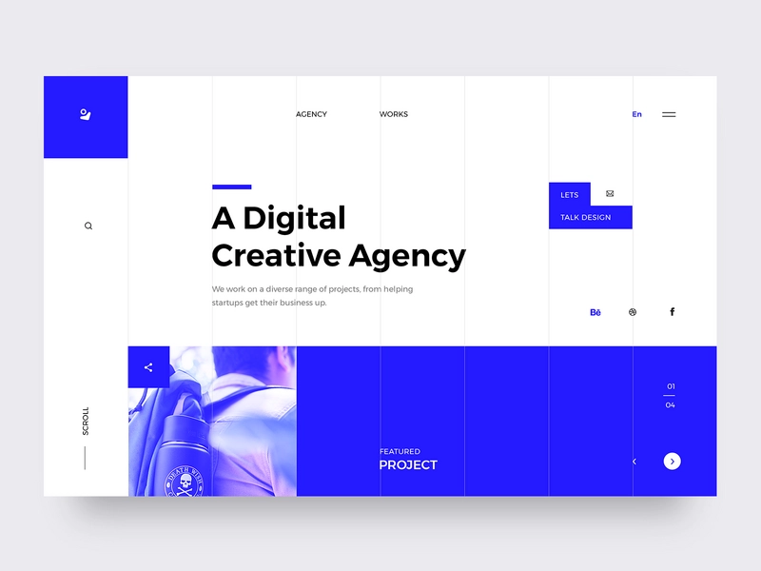
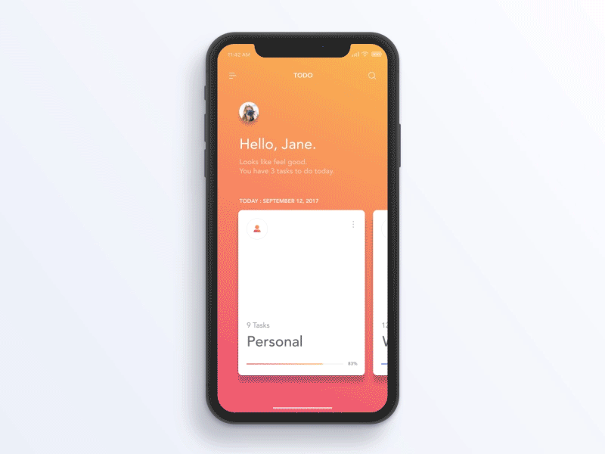
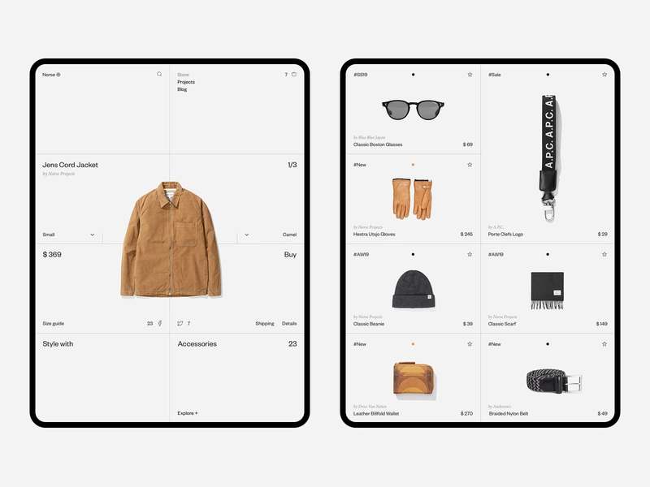
Website
Mobile
Tablet

Slide 4
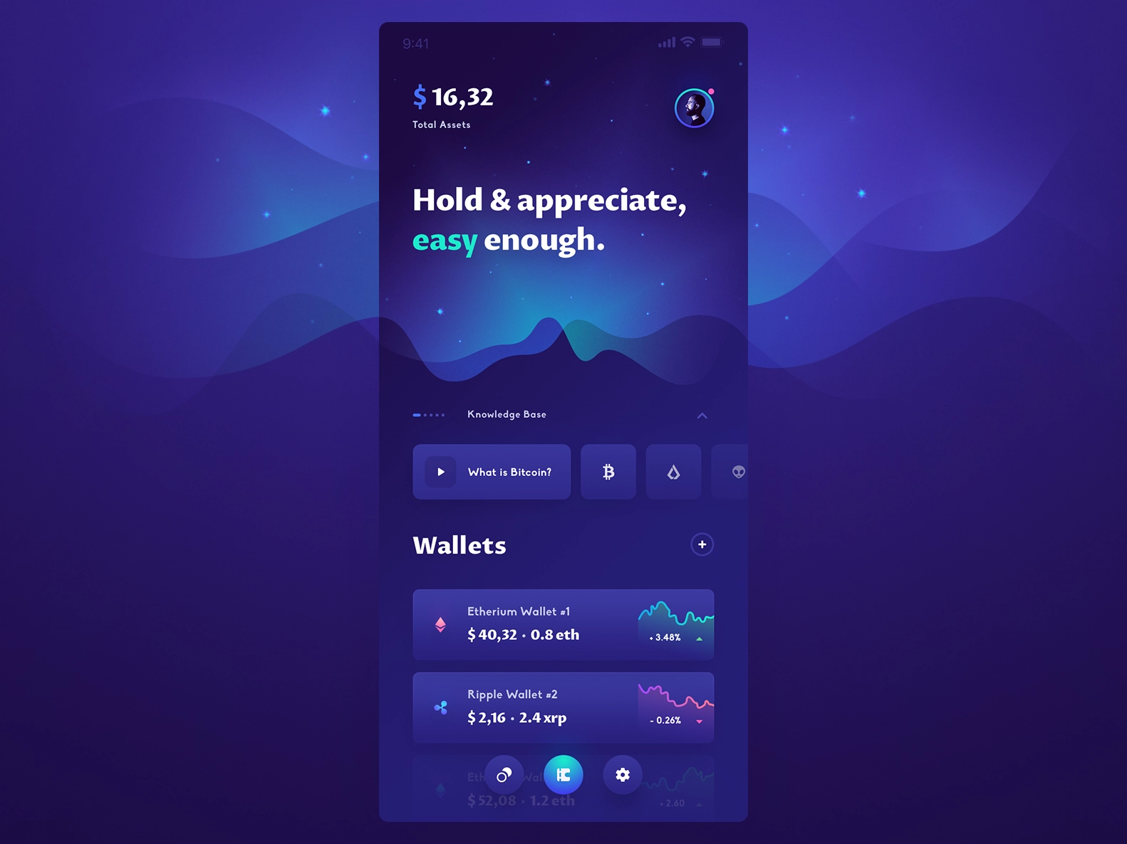
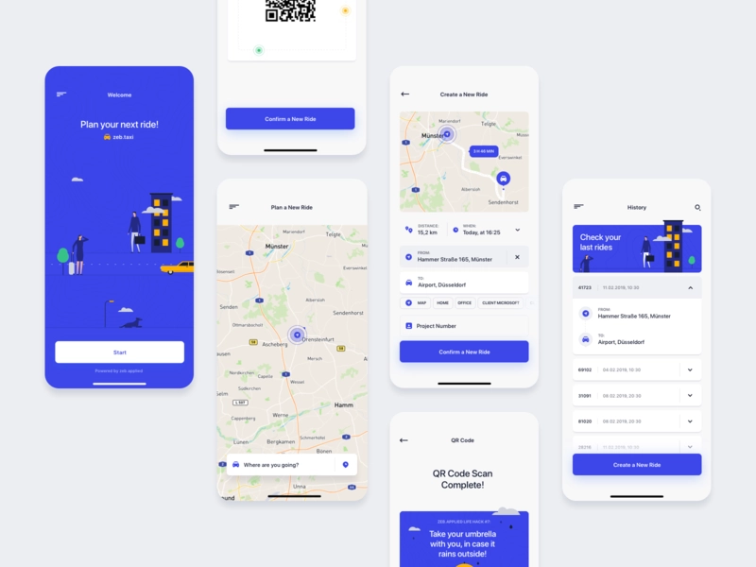
Mobile
Mobile
IphoneX
Application

Slide 5
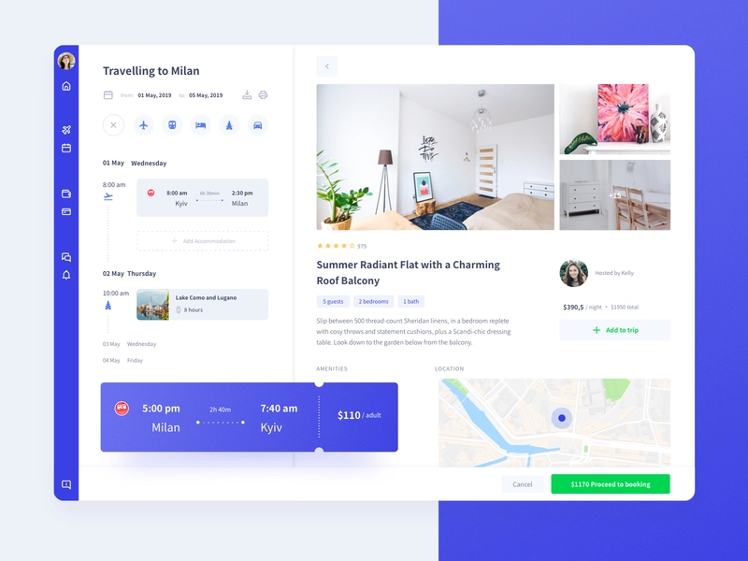
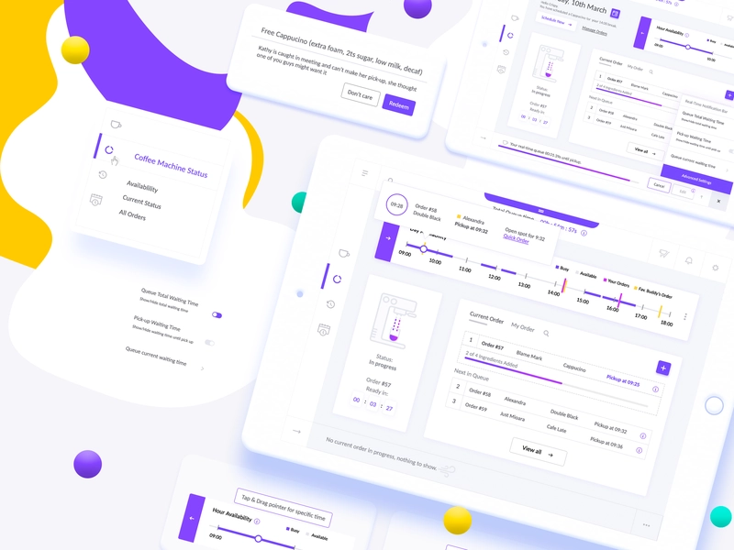
Tablet
Tablet
Ipad
Tablet design

Slide 6
COLOR
White | White, Clean, Snow, Light white clean minimal theme, Black white, #ffffff, Light mode
Yellow | Yellow, Golden, Orange, Gold
Red | Red, Maroon
Pink | Pink, Rose, Blush, Coral,
Purple | Purple, Violet, Magenta, Plum, Lavender
Blue | Blue, DarkBlue, SkyBlue, Azure, Sky, LightBlue, Indigo
Green | Green, DarkGreen, Aquamarine
Grey | Grey, Silver, DarkGray, Dull, Gray
Brown | Brown, Sandy, Chocolate, Sepia
Black | Black, Dark, Dark mode, Dark ui, Black dark theme blur, Night mode

Slide 7
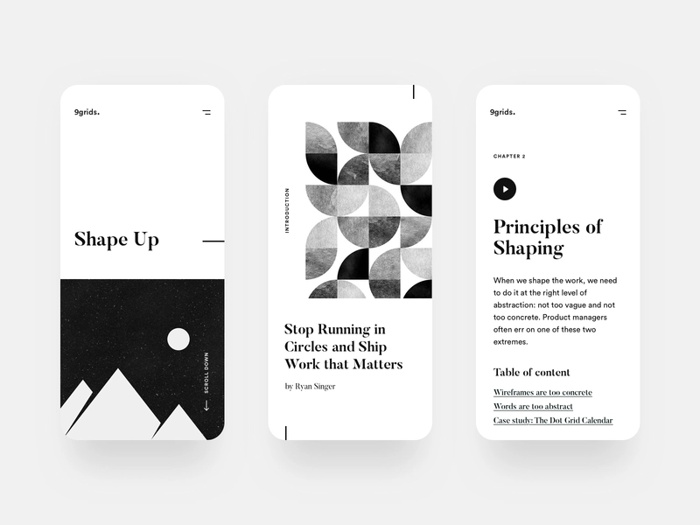
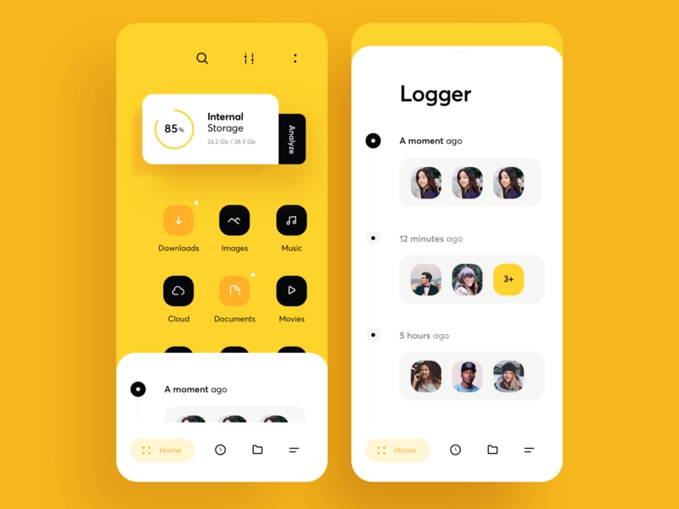
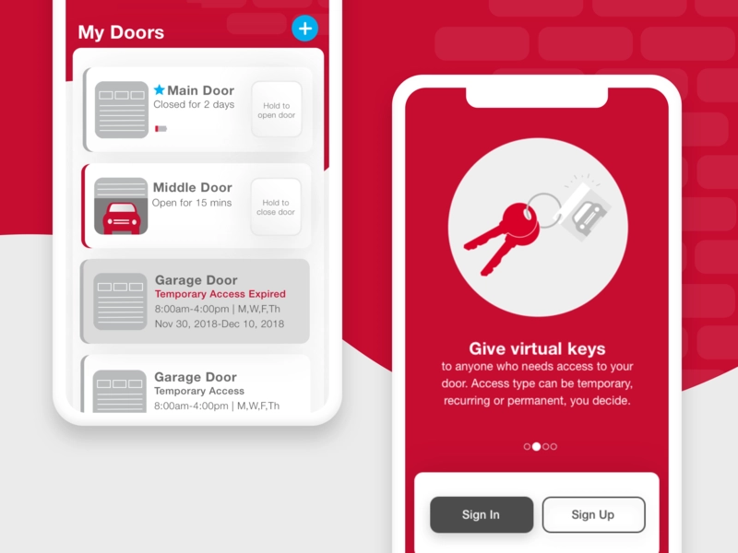
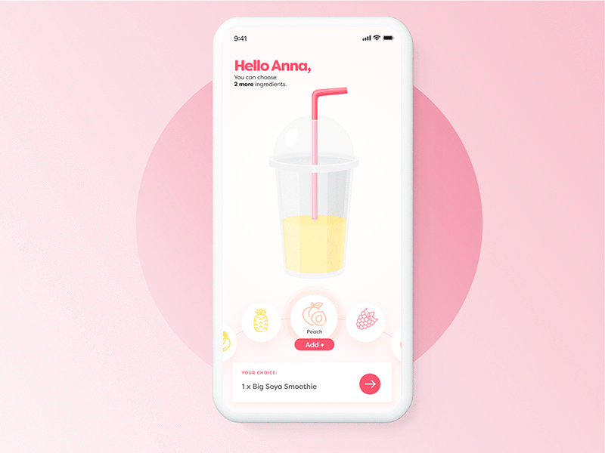
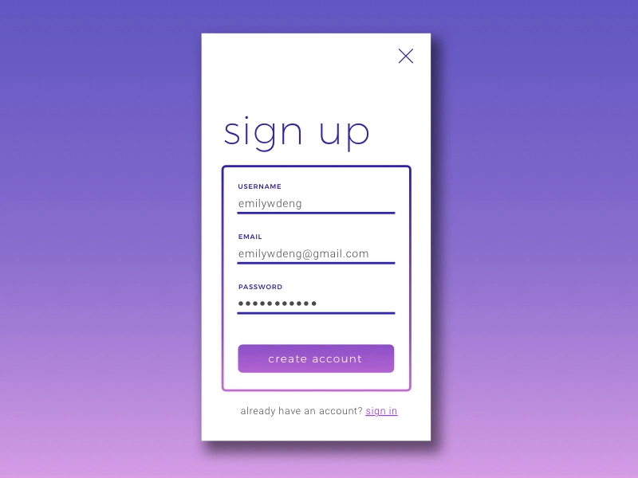
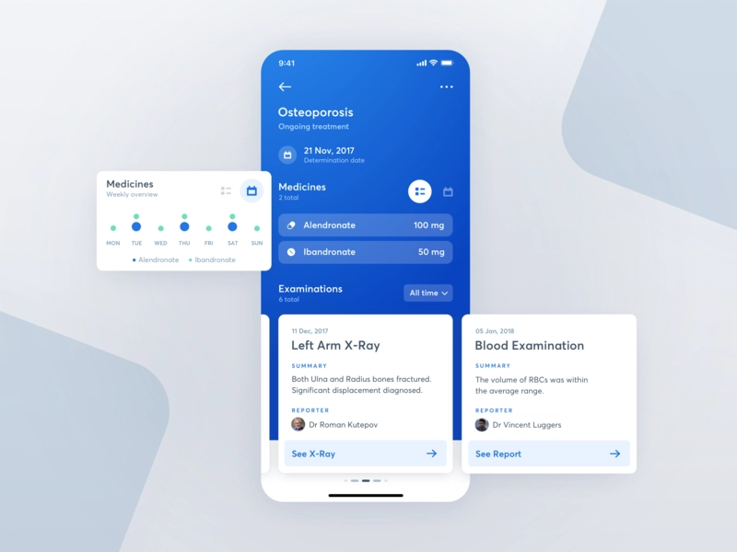
White
Yellow
Red
Pink
Purple
Blue

Slide 8
APP FUNCTIONALITY 1
Music | Music, Musicplayer, MusicApp, Apple_music, Playlist, Music_applications, Melody, Rap, Song, Singing, Studio
Food & Drink | Food, Restaurant, Grocery, Drink, Salad, Bakery, Steak, Cake, Recipe, Juice, Cola
Game | Game, Videogame, Gamer, Shooter, VR, Gamification, Fighting game, Dota, Csgo, Lol
Health & Fitness | Fitness, Health, Healthy, Health blog, Energy, Healthcare, yoga, Fitbit, Healthtracker
News | News, Aid, Newspaper, Articles, Journal, Magazine, Creative magazine, Editorial, Texture, The new york times
Sport | Sport, Gym, Workout, Football, Trainer, Personal training, Running, Exercise
Entertainment | Movie, TV, Netflix, Youtube, Video, Streaming app, Movie poster, Art
Kids | Kids, Children, Family, Cartoon, Boy, Girl, Teenager, Kids books, Toy
Medical | Medical, Healthcare, Hospital, Disease, Drug, Pill, Treatment, X-ray, Doctor, Blood pressure, Pharmacy, Dental, Patient
Navigation | DrivingAssistance, TopographicalMaps, PublicTransitMaps, Planner, Planet, Space, World

Slide 9
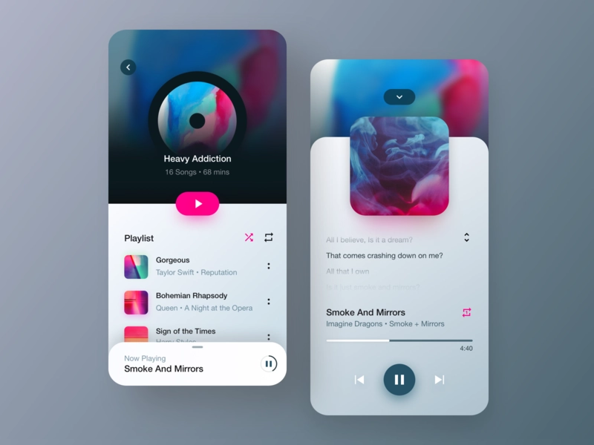
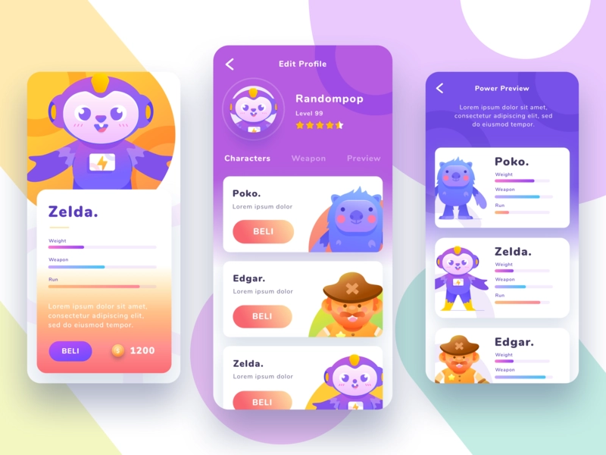
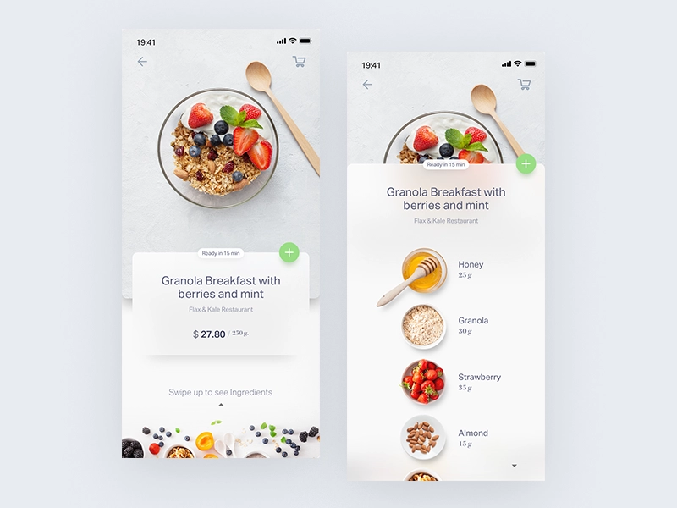
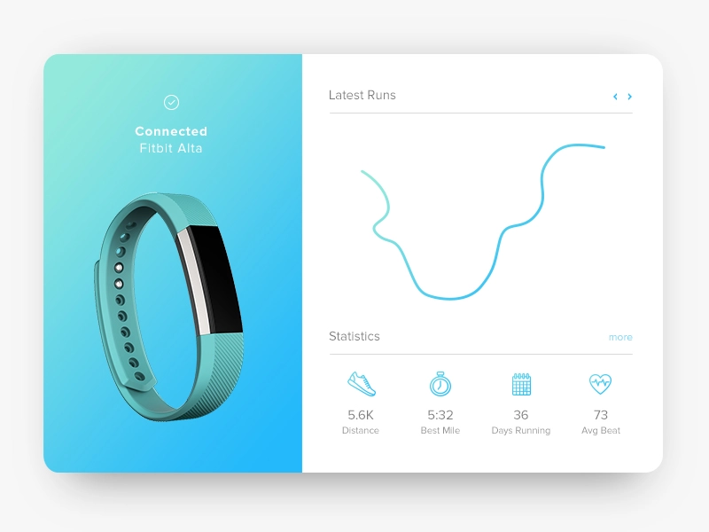
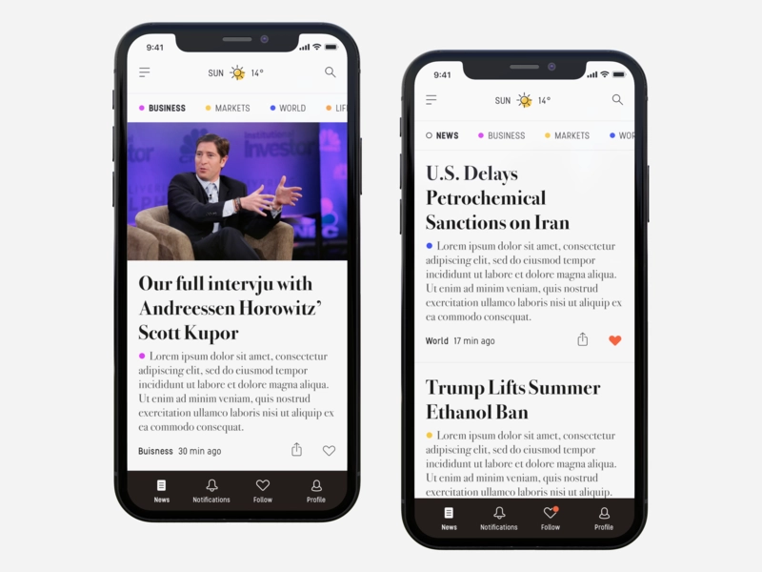
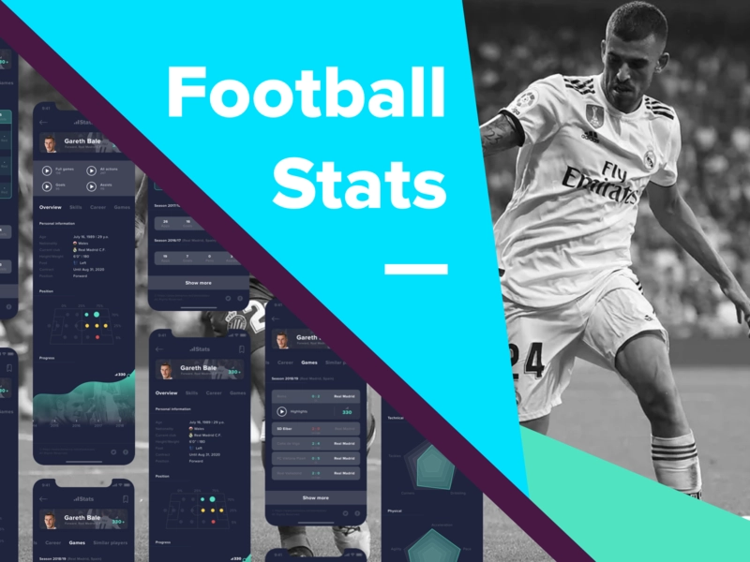
Music
Game
Food
Health
News
Sport

Slide 10
APP FUNCTIONALITY 2
Ecommerce | E-commerce, Store, OnlineShop, Ikea, Eshop, Adidas, Footwear, Clothes, Webshop, Statistics, Storages, Product
Social Networking | SocialNetwork, Blog, Messenger, Facebook, Instagram, Dating, Chat, Social media, Influencer, People
Travel | Travel, Trip, Tourism, Tour, Drive, Backpack, Ride, Country, Iceland, Transport, City guides, Flight, Travel agency, Vacation, Sea, newyork, Schedule, Tickets, Car, Fly, Hotel
Weather | WeatherApp, Temperature, Season, Winter, Summer, Cold, Warm, Rain, Sunny, Colour weather, Sunrise, Forecast, Umbrella
Education | Education, E-learning, Knowledge, Learning, Lesson, Maths, Study, Student, Languages, Education course, Geometric, Growth, Science
Reference | Dictionary, Atlas, Encyclopedia, Information, Guidelines, Specification, Documentation, Theme
Books | Books, DigitalReading, DigitalBookstroe, Reading, Bookstore, Magazine
Finance | Finance, Wallet, Bank, Business, Insurance, Marketing, Price, Luxury, Management, Spending,Currency, Coins, fintech
Utilities | Calculator, Clock, Measurement, WebBrowser, Alarm, Timer, Toolbar, Piechart, Gas, Calendar

Slide 11
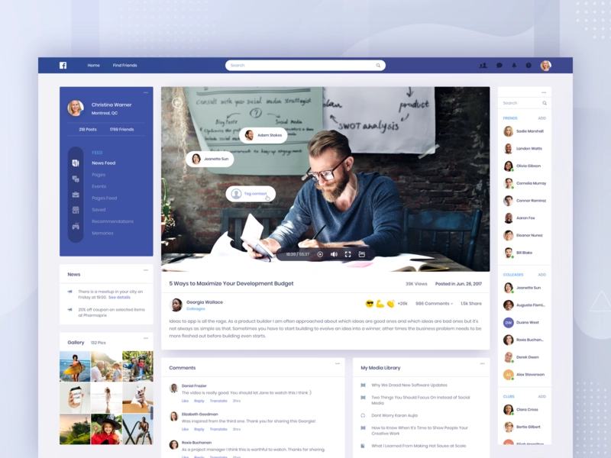
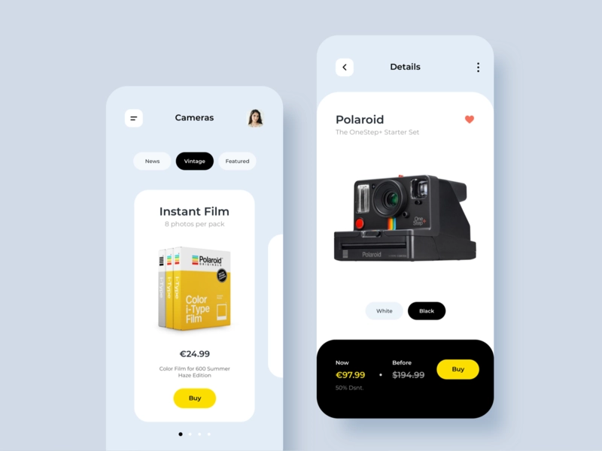
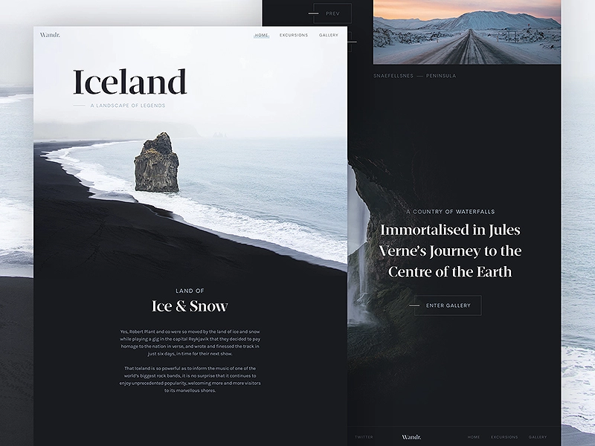
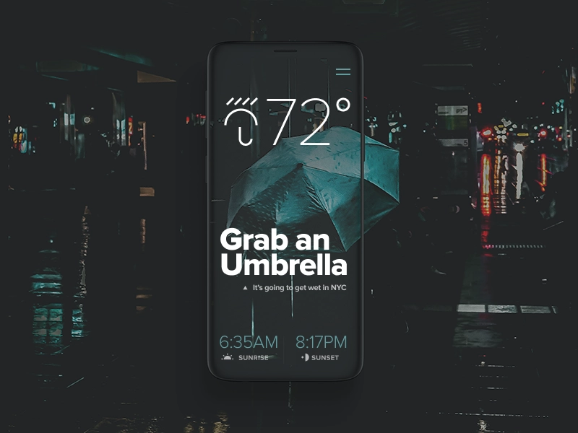
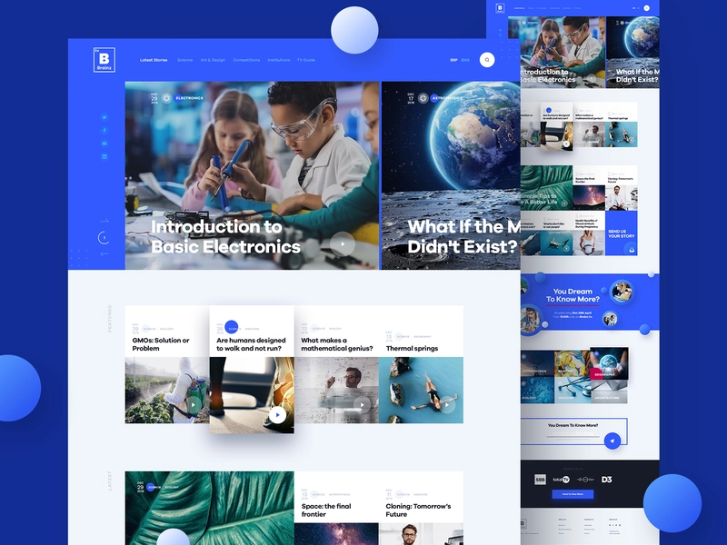
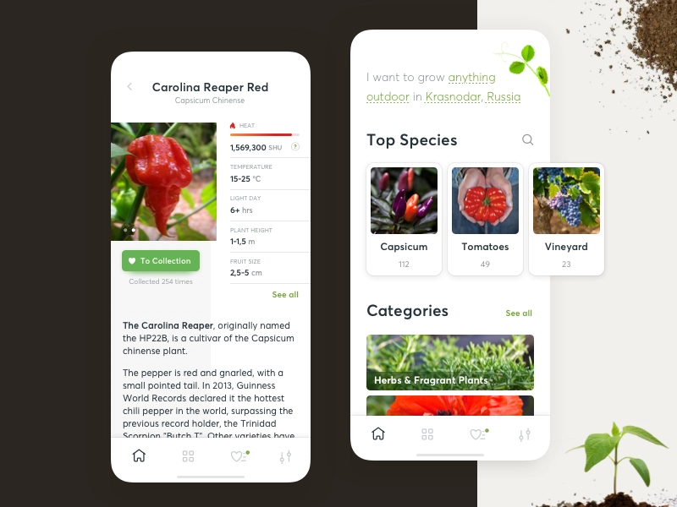
Social
Ecommerce
Travel
Weather
Education
Reference

Slide 12
(SCREEN) FUNCTIONALITY
Landing page | Landingpage, Landing page, Landing, Welcome, Homepage, Home
Login | Login, Signin, Onboarding, Sign in, Log in, login app, Login page
Signup | Signup, Registration, Register, Account, Createaccount, Enroll, Welcome login signup screen, Join, Verification
Checkout | Checkout, Payment, Credit card, purchase, cart, card, pay, credit, creditcard
Search | Search, Job search, search engine, search app, search result, searchbar, searchjob, search bar, searching, product searching
Profile | Profile, illustration, graphics, profile page, photo, portrait, user profile, illustrator, mockup, user profile, Portfolio, cartoon, character
Contact Page | Contact, Contact page, Contact us, Consultation, Social contact, Faq, Help, Contact form, Contact list
12

Slide 13
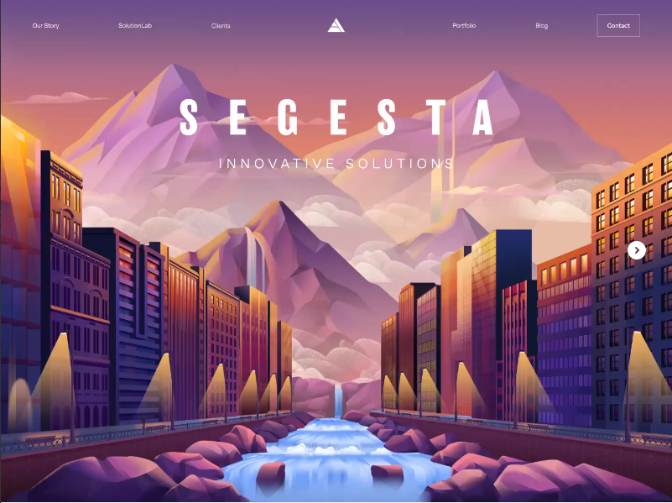
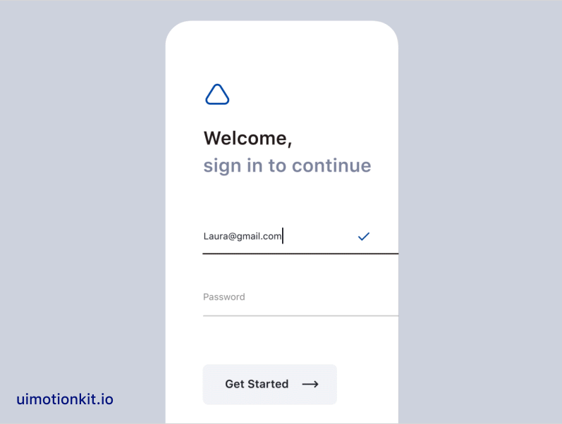
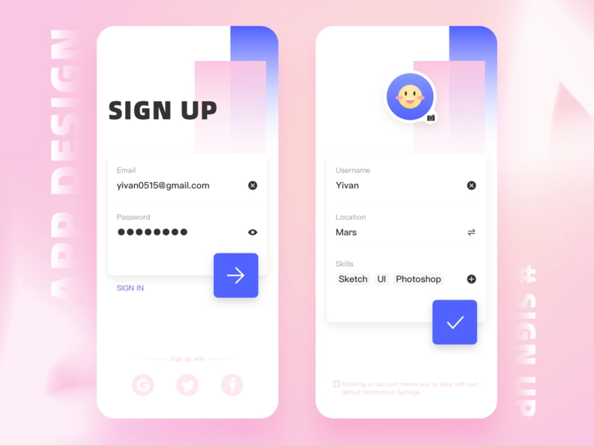
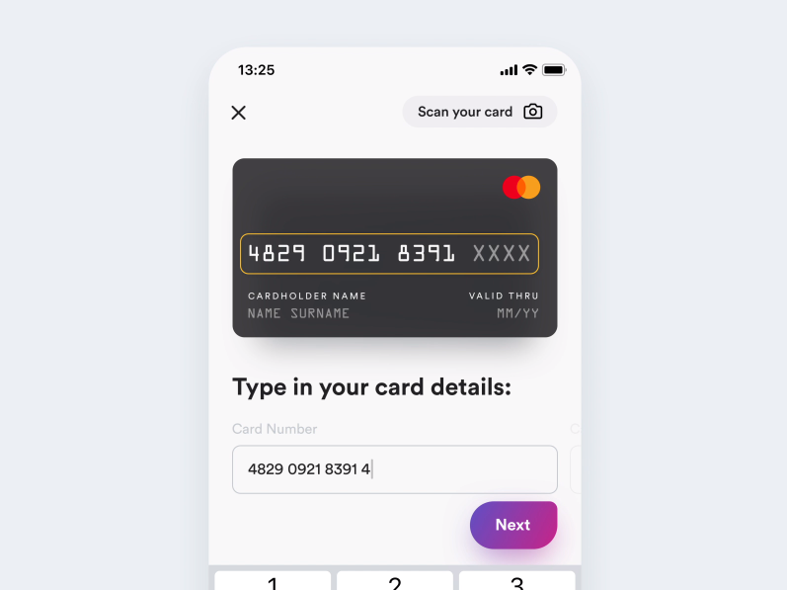
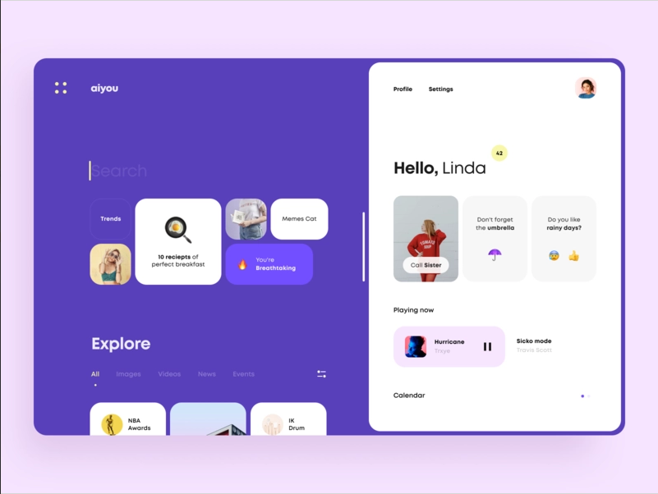
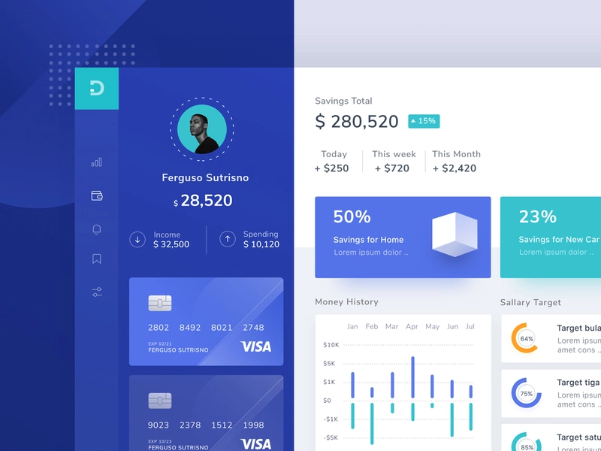
Landing page
Login
Signup
Checkout
Search
Profile

Slide 14
(SCREEN) LAYOUT
Dashboard | Dashboard, Dashboard ui, Desktop, Smart home dashboard, Customer dashboard, Control panel, Dash board, Admin panel
Form | Form, Input fields, Form builder, Form design, Form elements, Long form, Fill in
Table | Table, Data table, Table design, Summary table, Setting table, Statistic_table, Data analytics table, Pricing table
List | List, Listing, Paylist, Todolist, Playlsit, Dropdown, Watchlist, Task list, Tracklist, Empty list, Project list, Wishlist, Shop list, Order list, Waitlist, Shopping list, To-do list
Grid | Grid, Grids, Logogrid, Broken grid, Gridding, Grid system, Golden grid, Golden ratio grid
Gallery | Gallery, Drawingart, Diagram, Image, Illustration, Galerie, Photo. Photography, Photographer, Art gallery, Exhibition, Drawing
Toolbar | Scroll, Toolbar, Toolbox, Toolbar icons, Tools, Tabbar, Tabs, Bottom bar, Bottom nav, Menu, Menu bar, Icons, Sider, Category menu, Navigation bar, Line icon, Transition, Bottom navigation, Navbar,
Chart | Chart, Graph, Analysis graph, Statistics, Gauge, Diagram, Data visualization, Data analytics, Pie chart, Flow chart, Analytics, Analytics chart
Map | Map. Mapa, Map view, Maps, Ui map, City map, Navigation, Mapping, World map, Heat map

Slide 15
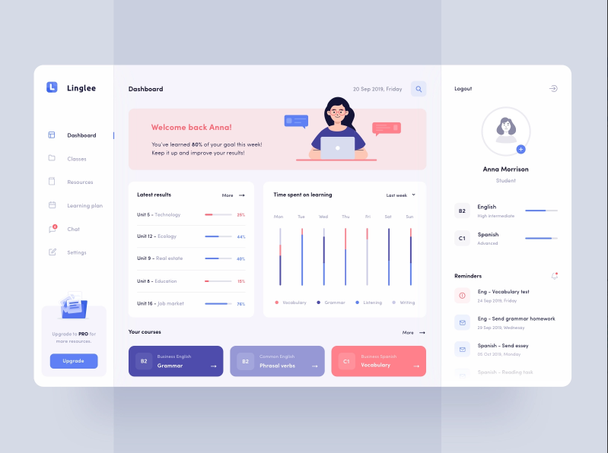
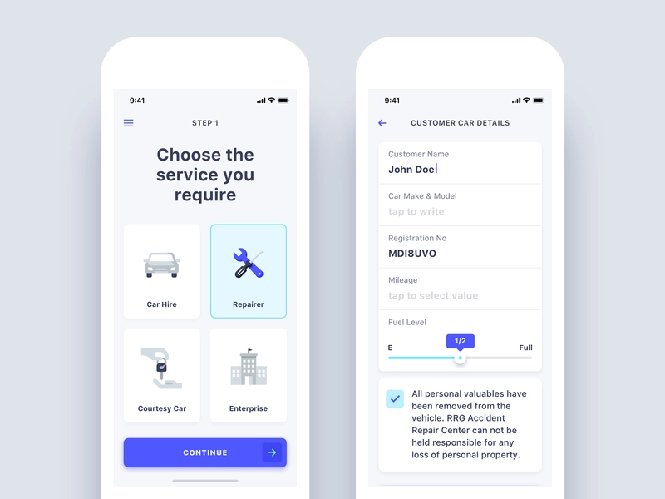
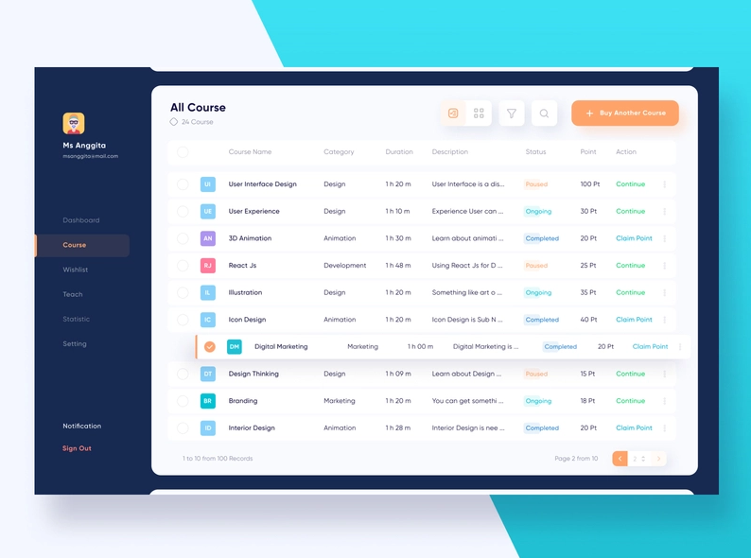
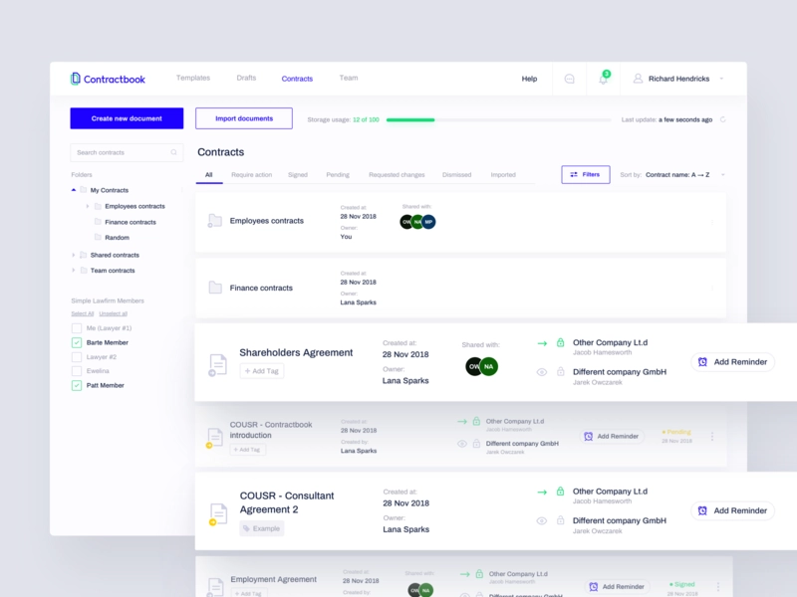
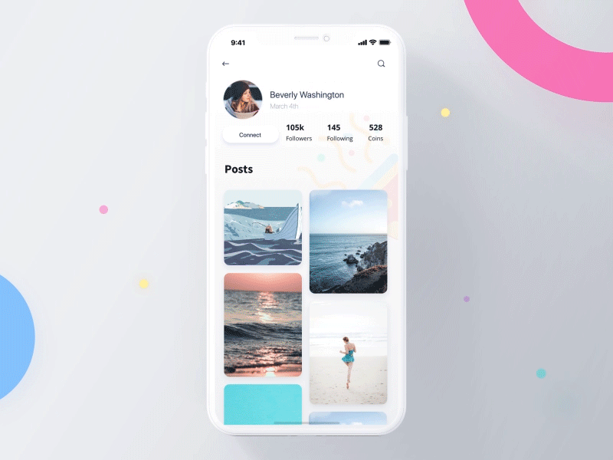
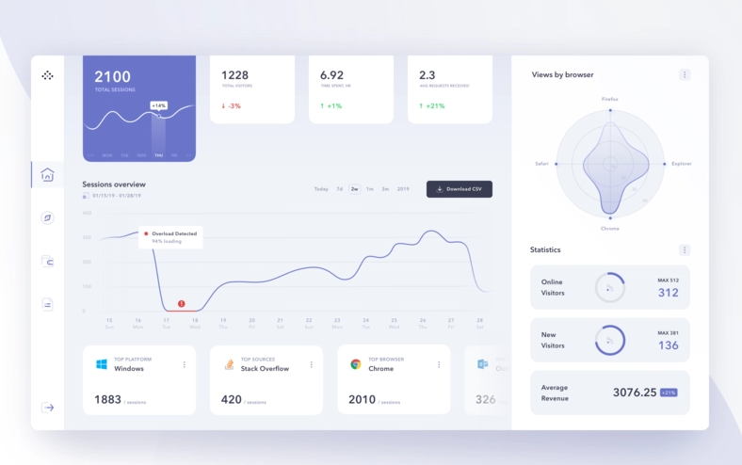
Dashboard
Form
Table
List
Grid
Chart

